Slide 1
ATTENTION
  Use this document to teach your end-users why they need cybersecurity.
  Remember to delete this slide before presenting.
  You may update this PPT with your own branding or present as is. Be sure to double check all formatting before presenting

Slide 2



| 2025
Why Invest in Security Awareness Training?
Statistically Speaking

Slide 3




AGENDA
01.
Top excuses for not investing in cybersecurity
02.
The truth behind these excuses
03.
Why invest in Security Awareness Training?
02

Slide 4



Top Excuses
for Not Investing in Cybersecurity
My business is too small to be targeted in a cyberattack
Cybersecurity
is too expensive
Cybersecurity is a productivity blocker
Cybersecurity
is common sense and doesn’t require training
Once a year security awareness training is enough
03

Slide 5

These excuses are hurting your business.
Here’s how
04

Slide 6
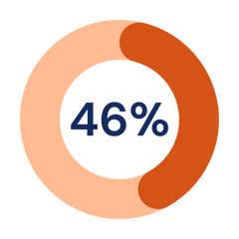



1
No business is too small for a cyberattack
of all cyber breaches impact businesses with less than 1,000 people
SecureWorld
If cyber criminals will go after individuals making less than $50,000 per year, what makes you think they won’t go after your small business?
  Cybercriminals steal because it’s easy to see quick results.
  They’re not looking for the biggest fish to catch, they’re looking for the easiest
  An estimated 15-30% of Americans are scammed in a year, losing $1,600 on average
  Higher rate of individuals being scammed among lower-income adults with less education
SMBs
Walmart, Google, Microsoft, etc.
https://www.ipx1031.com/fraud-and-identity-theft-in-america/
05
https://news.gallup.com/poll/544643/scams-relatively-common-anxiety-inducing-americans.aspx

Slide 7

2
Cybersecurity is less expensive than a breach
Average cost of a data breach measured in millions of USD
0.43
Cyber attacks on small businesses can cost thousands to millions of dollars when you factor in the following:
  Stolen money
  Downtime
  Disaster recovery resources
  Legal fees
  Repairing damaged reputation
Basic cybersecurity tools and processes can cost as little as a few thousand dollars per year.
$5
0.37
0.27
0.21
1.35
$4
0.21
0.24
1.20
1.14
1.18
1.07
0.99
$3
1.58
1.63
1.24
1.44
1.22
1.11
$2
1.42
1.52
1.59
1.42
1.47
$1
1.30
$0
2019
2020
2021
2022
2023
2024
Lost Business
Detection & Escalation
Post Breach Response
Notification
IBM: Cost of a Data Breach Report 2024
https://purplesec.us/learn/data-breach-cost-for-small-businesses/
06
https://www.embroker.com/blog/cost-of-a-data-breach/

Slide 8
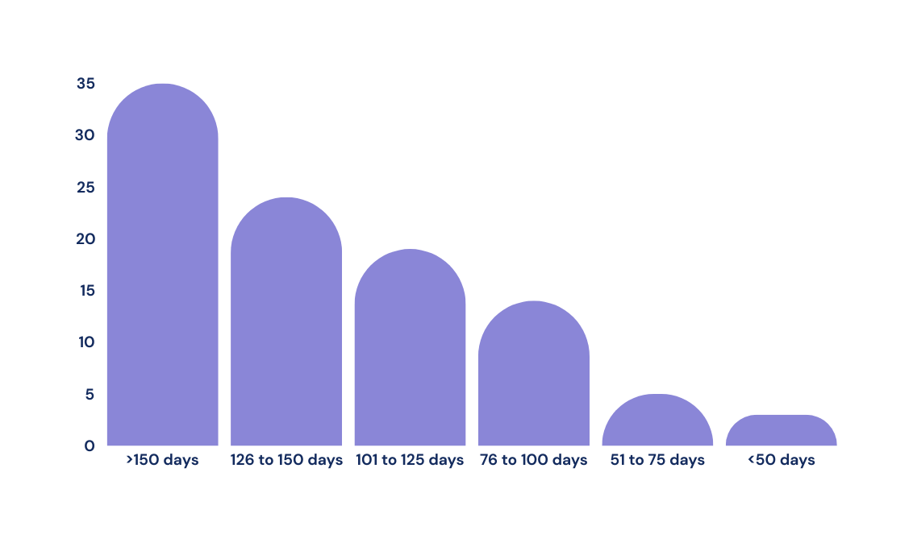

3
If cybersecurity slows you down, you’re doing it wrong
Top 3 reasons people
bypass security measures:
  A breach can cost you days, months, and even years of productivity
  IBM surveyed organizations that underwent a data breach. This was the average recovery time (not including those that hadn’t yet recovered):
1
2
3
35%
Convenience
Save time
Meet an urgent deadline
How much time does it really take?
24%
19%
Multi-Factor Authentication
Software Updates
30 seconds/login x 5 logins = 2.5 min
Automatic and can be done overnight
14%
Security Awareness Training
Review emails for phishing
3%
5 min or less /month = 1 hour/year
7 seconds/email x 100 emails < 12 min
5%
https://www.ibm.com/downloads/documents/us-en/107a02e94948f4ec
07
https://www.proofpoint.com/sites/default/files/threat-reports/pfpt-us-tr-state-of-the-phish-2024.pdf

Slide 9
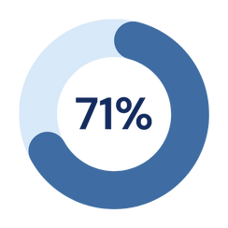
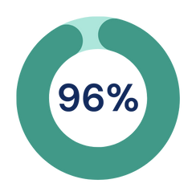

4
It’s not about common sense — mistakes happen
  Multitasking and working quickly is a recipe for disaster
  People know cybersecurity basics but don’t make it a habit
  Employees need frequent reminders of why cybersecurity is necessary and relevant to them
of surveyed users said they took a risky action in 2024
of users knew they were taking a risky action
Proofpoint: 2024 State of the Phish
Oops
Plus, technology changes so rapidly, and scams evolve with that technology. Employees need to be up to date on the most recent threats.
08

Slide 10



5
Once a year security awareness training is too long, boring, and irrelevant
  Threats evolve constantly
  Once a year training leaves you vulnerable to new threats throughout the year
  Annual training tends to be long and boring (It’s like studying for your 6th-grade history test, only to immediately forget everything once you go on summer vacation.)
  Frequent and shorter trainings are easier to remember, more relevant, and more engaging
Everything you need to know to stay safe online
Duration: <5 minutes
Frequency: 1 / month
Content: Engaging cartoon about a recent, real world cyber attack.
  Digestible
  Relevant
  Engaging
Duration: 1 hour
Frequency: 1 / year
Content: An overview of everything you need to know about cybersecurity.
  Overwhelming
  Irrelevant
  Boring
Both = the same amount of training in 1 year
09

Slide 11
Why should you invest in effective security awareness training?
10

Slide 12
Human error
is the #1 cause
of breaches.
11

Slide 13
Employees at small businesses are more likely to receive social engineering attacks than employees at large enterprises.
Top 3 users most at risk of a breach
Users with access to business-critical data
Click happy users
Users who consistently fail to complete training
https://www.forbes.com/sites/edwardsegal/2022/03/30/cyber-criminals/
12

Slide 14
Phishing is the...
2nd
most prevalent attack method
  It can take over 250 days to respond to phishing and social engineering attacks
  SAT is proven to reduce phishing clicks
3rd
most costly attack method
(avg of $4.88M)
IBM: Cost of a Data Breach Report 2024
https://www.ibm.com/downloads/documents/us-en/107a02e94948f4ec
https://blog.usecure.io/does-security-awareness-training-work#:~:text=In%20a%20recent%20study%2C%2080,within%20the%20first%2012%20months.
13

Slide 15
What’s holding you back?
14

